Slide 1


POST EVENT
REPORT 2025
Construction Jobs Expo
11th October 2025, RDS, Dublin

Slide 2





AT A GLANCE
1072
21
Registered Candidates
Employers
29
5
10
Operating
Companies
Career Coaches
Keynote Speakers
Post event report 2025
01

Slide 3



















CONSTRUCTION / ENGINEERING EMPLOYERS
Post event report 2025
02

Slide 4

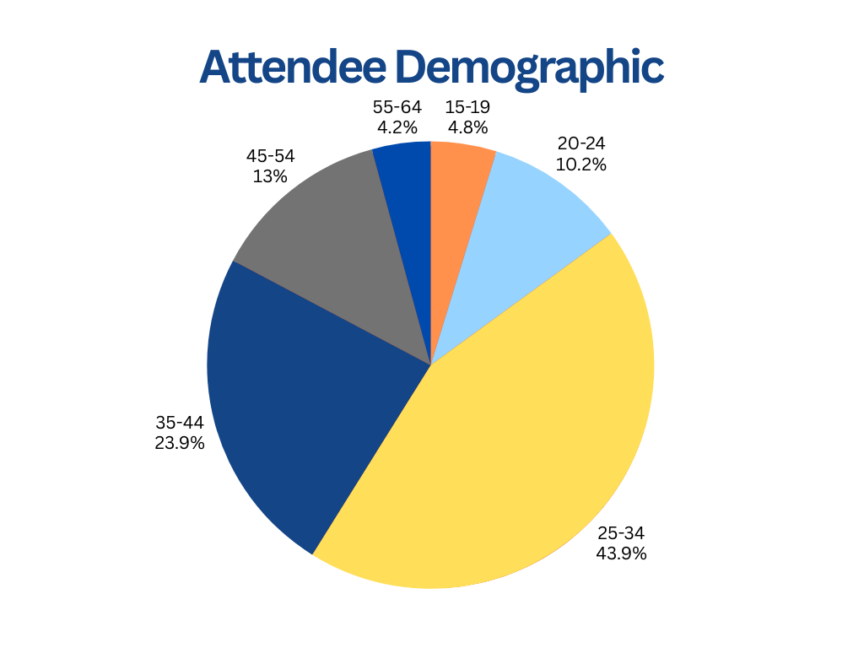
21%
Virtual
48%
Virtual
52%
Live
79%
Live
Post event report 2025
03

Slide 5

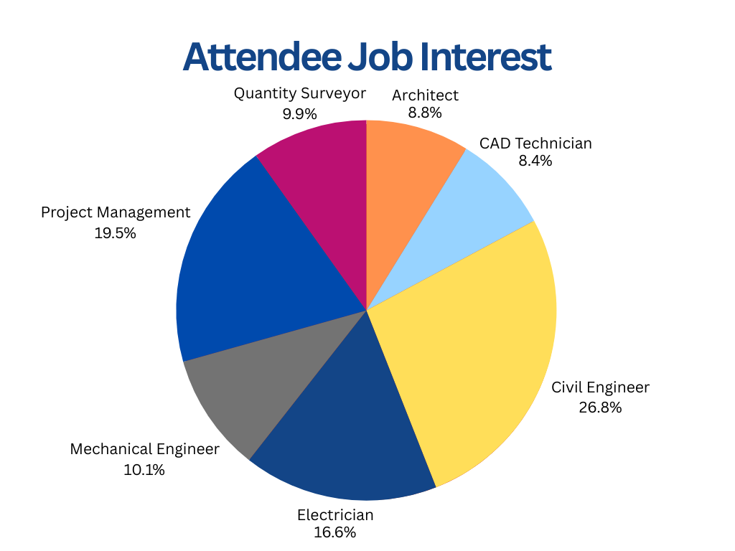
21%
Virtual
48%
Virtual
52%
Live
79%
Live
Post event report 2025
04

Slide 6

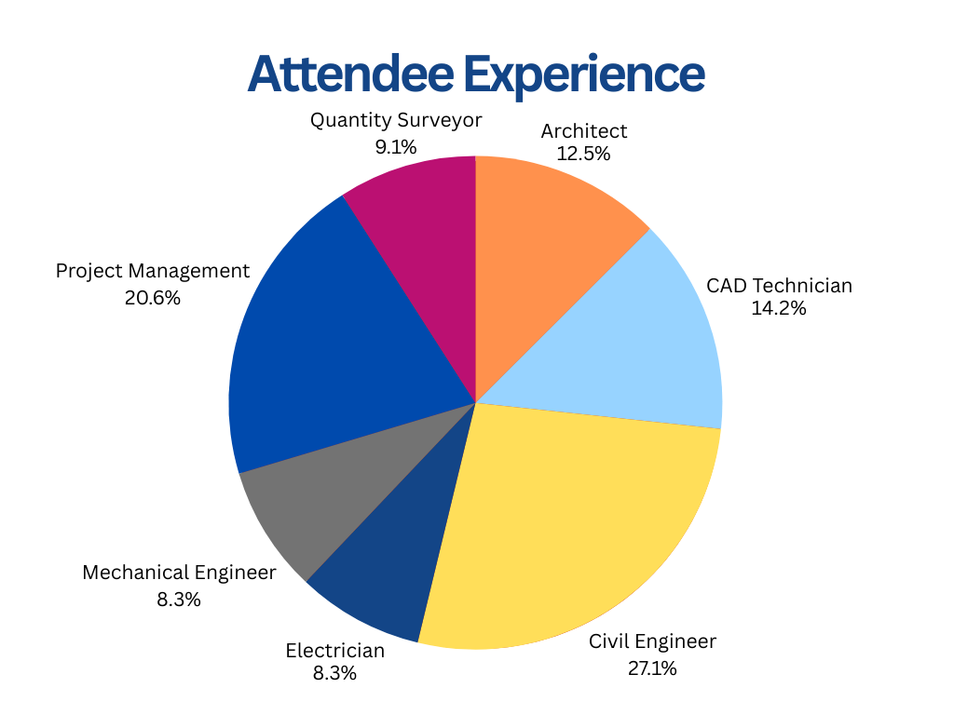
Post event report 2025
05

Slide 7

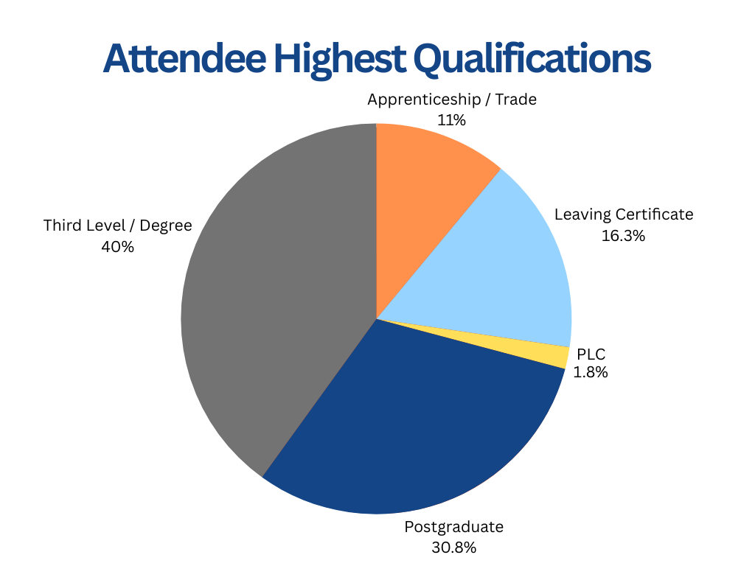
Post event report 2025
06

Slide 8


TESTIMONIALS
Construction Jobs Expo at the RDS has been an incredible success for us at Pentacon. We’ve had the opportunity to meet talented individuals from all over the world and the quality of their experience has truly impressed us. This event has been a major success and we’re thrilled with the connections we’ve made here today. – Sandy Miller, Pentacon
The Construction Jobs Expo at the RDS has been very successful for us. The face-to-face interactions are invaluable, allowing us to connect directly with candidates and provide a human touch that’s often missing in online applications. It’s been a fantastic day for networking and meeting potential employees. – Brian & Jimmy, Ward Personnel
Construction Jobs Expo at the RDS has been fantastic for us at Skanstec. We’ve received a lot of quality CVs and have seen significant footfall. There’s been a noticeable boost in our social media engagement as well, with many attendees using our QR codes. Overall, it’s been a highly productive and successful day. – Dawn Meagher, Skanstec Engineering
Post event report 2025
07

Slide 9
RESERVE YOUR SPACE FOR 2026
2026
Construction Jobs Expo
RDS
17th October• Dublin, Ireland
Post event report 2025
08

Slide 10

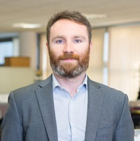
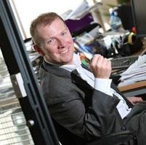
CONTACT
For further information please contact:
Sales: Emma Cash
Phone: 086 045 0480
Email: emma@careers.ie
Michelle Bingham
Sharon Phillips-Davies
Senior Marketing
Manager
T: +44 20 7903 2091
E: kay.beloe@crugroup.com
Sponsorship & Exhibitions Customer Support Manager
T: +44 207 903 2402
E: sharon.phillips-aviescrugroup.com
Marketing: Cormac O’Meara
Phone: 083 158 9997
Email: cormac@careers.ie
Accounts: Kevin Branigan
Phone: 087 267 9047
Email: kevin@careers.ie
Post event report 2025
09

Slide 11


